Slide 1
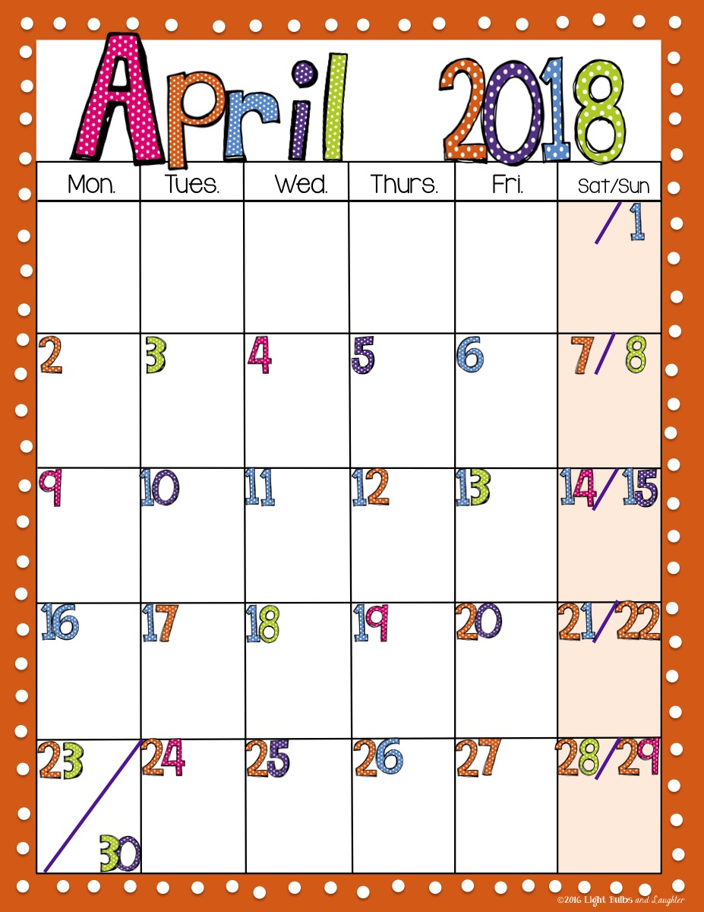
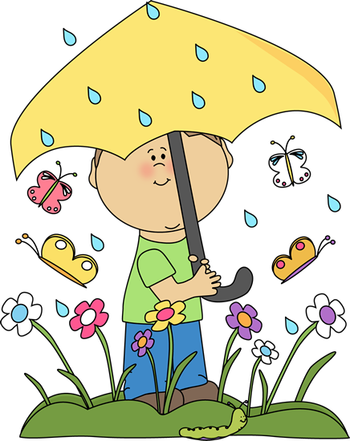
Mrs. Asbill
and Mrs.
DeProspero’s
Class
A
Art
Music
No
Special
PE
STEM
D
Report
Cards
Media
No
Special
Art
Music
No
Special
STEM
Field
Trip
IMAX
No
Special
Art
PE
Cultural Arts
Program

